Slide 1
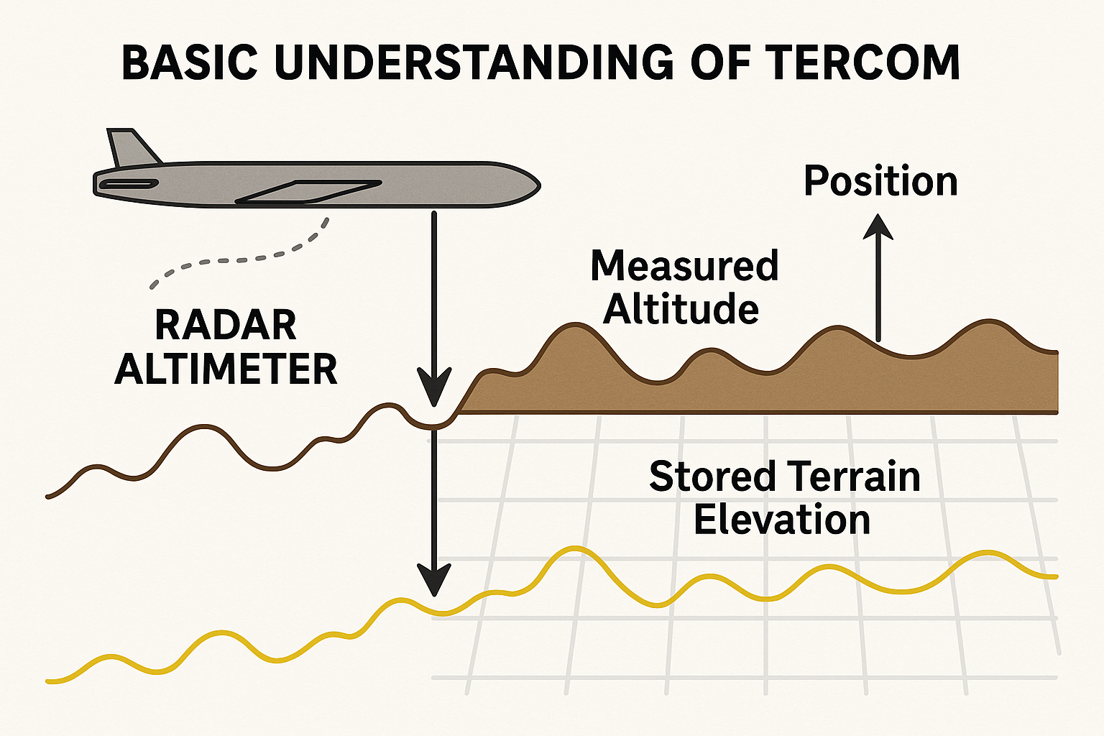
Terrain Contour Matching (TERCOM)
By Nupur Khandale
Guides: Dr. Odellu Ojella (DIAT)
A. Kalidasu, Sci ‘E’(RCI)

Slide 2
Problem Statement
Application where a drone flies in a custom 10×10 km map and navigates through a predefined trajectory on a simulation platform using TERCOM.

Slide 3
Literature Survey
TERCOM origins: cruise missile navigation in GPS-denied conditions.
Recent applications in UAVs for GPS-denied navigation.
Comparative studies with INS and DSMAC.
Combining a terrain server, DEM/LoS matching, and an AI mode manager switching between EKF/UKF/PF. (Bekar…Aerospace, 12(6) , 501).
REFERENCES:
Bekar, Ü. C., Tanyeri, B., Uslu, I. E., Gungor, N. A., & Inalhan, G. (2025). Validation of an AI-Assisted Terrain-Aided Navigation Algorithm Using Real-World Flight Test Instrumentation Data. Aerospace, 12(6), 501.

Slide 4
Core Insights
TERCOM relies on correlation of measured terrain elevation profiles with stored Digital Terrain Elevation Data (DTED).
Effective in rugged terrain, less effective in flat terrain.
Needs integration with INS/IMU to correct drift between fixes.
Confidence score maps used for robust position estimation.

Slide 5
General Approach
Generate or import a custom 10×10 km terrain map.
Define a predefined UAV trajectory across this map.
Simulate altimeter + IMU sensor data with added noise.
Apply TERCOM algorithm:
Compare sensed profile with DTED.
Calculate correlation score.
Correct UAV position estimates.
Evaluate against ground truth trajectory.

Slide 6
Applications
UAV navigation in GPS-denied zones (urban canyons, tunnels, forests).
Military reconnaissance and surveillance in hostile environments.
Disaster relief UAVs where GPS infrastructure is down.
Potential for planetary exploration where GPS is absent.

Slide 7
Progress
Completed: Study of working of TERCOM algorithms.
In-progress: Finding DEM data from USGS Earth Explorer for a terrain.
Next:
Building the simulation environment with UAV + 10×10 km terrain.
Implement sensor fusion (TERCOM + INS) and test under noise conditions.
Future: Extend to hybrid navigation (TERCOM + Vision).

Slide 8
THANK YOU!

